Slide 1

Simple Shopping System
In python
By wang yuchen

Slide 2
Simple Shopping System
In python
By wang yuchen

Slide 3
Intro:
The project is targeting on implementing a simple shopping terminal(admin)
At this terminal, the below several functionalities will be applied:
Insert/Delete Categories, Products, Customers, and Orders
Place orders for customers
Get the total sales
Based on the product ID
Based on the category
Based on the sorted sum prices(for each product)
Based on the location of the customer

Slide 4
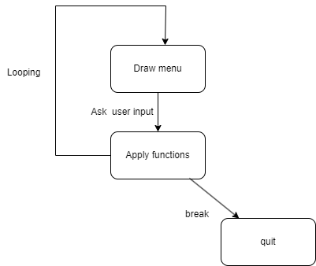
Intro:
The project is targeting on implementing a simple shopping terminal(admin)
At this terminal, the below several functionalities will be applied:
Insert Categories, Products, Customers, and Orders
Place orders for customers
Get the total sales
Based on the product ID
Based on the category
Based on the sorted sum prices(for each product)
Based on the location of the customer
Flow chart

Slide 5
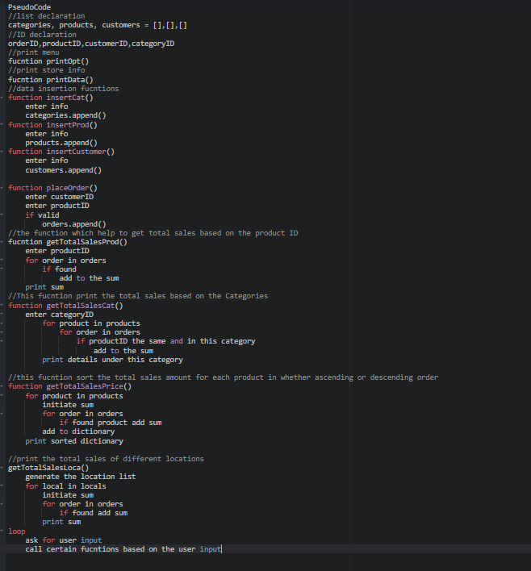
Pseudocode

Slide 6
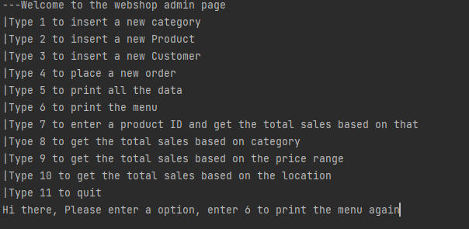
Sample output

Slide 7
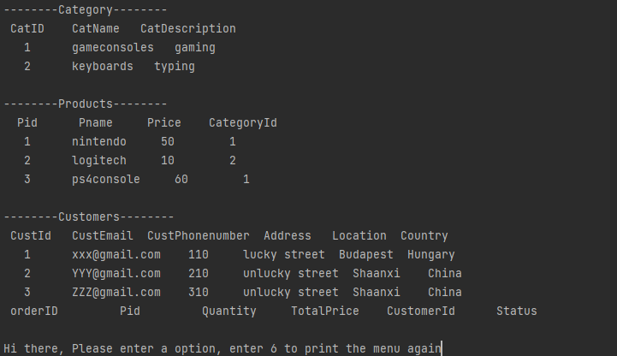
Print all the info

Slide 8
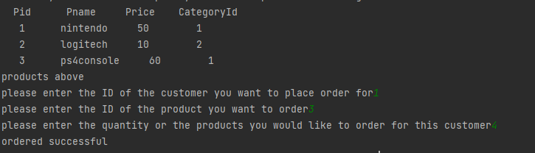
Adding orders

Slide 9
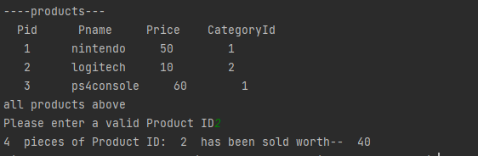
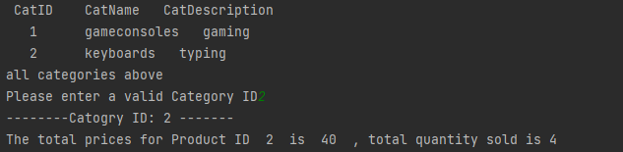
Total sale fucntions

